Slide 1
The Problem of Teaching Literacy Backwards
Core Advocates Monthly Webinar
July 11, 2018
The webinar will begin shortly.
Notes:
Handouts:

Slide 2

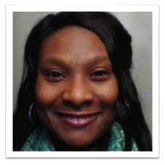
Introductions
This Month’s Guests:
David Liben
SAP Fellow
Aliya Washington
Core Advocate Guest
Your hosts from the Professional Learning Team:
Jennie Beltramini, SAP Math Specialist
Tori Filler, SAP ELA Specialist
Nicole Bravo, SAP Project Manager

Slide 3
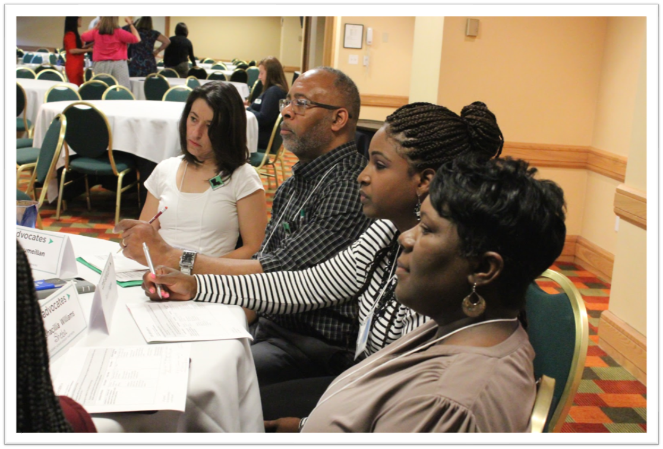
Who Are Core Advocates?
Core Advocates are educators who:
Believe in the potential of high-quality standards to prepare all students for college and careers;
Are eager to support their colleagues and communities in understanding and advocating for the college- and career-ready standards, and standards-aligned instruction;
Understand and embrace the Shifts in instruction and assessment required by the college- and career-ready standards.
Notes:
The Core Advocate webinar series was born to extend and support the Core Advocates program, and the chance to help teachers implement changes in their classrooms – give very brief info on CA here

Slide 4

To Learn More About Core Advocates…
Contact Jennie Beltramini (jbeltramini@studentsachieve.net)
Complete this survey to join our database (and mailing lists): http://bitly.com/joincoreadvocates
Visit our website: www.achievethecore.org

Slide 5

Tweet with Us
Please feel free to tweet during and after the webinar using #coreadvocates
@achievethecore
@JennieBeltro

Slide 6
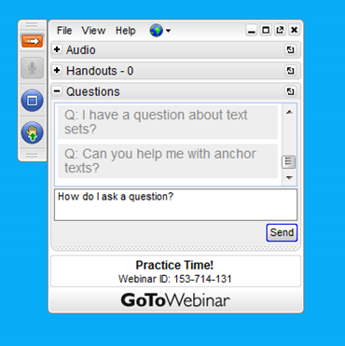
Webinar Protocols
During the webinar
– Accessing Documents
– Questions option
– Polling
After the webinar
– Survey
– Access to recorded webinar

Slide 7

Review recent educational research as well as cognitive science works on building strong readers.
Consider instructional methods that are aligned and unaligned with this evidence base.
Learn about one district's transition to structured phonics and a knowledge-rich curriculum.

Slide 8
Section 1: What does new research tell us about building strong readers?

Slide 9
Poll:
What percentage of your students are fluent readers of grade level text?
If you work with Kindergarten or Grade 1, what percentage of your students are on track to meet this goal?

Slide 10
David Liben
Fellow
Student Achievement Partners
dliben@studentsachieve.net

Slide 11
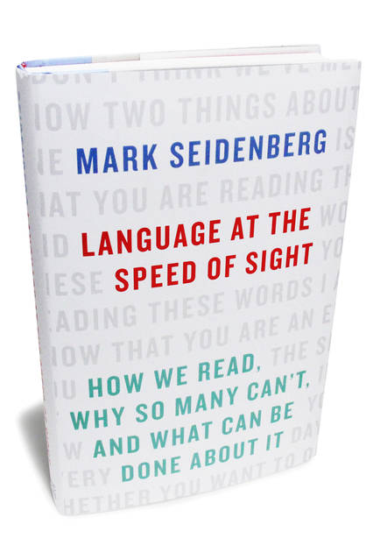
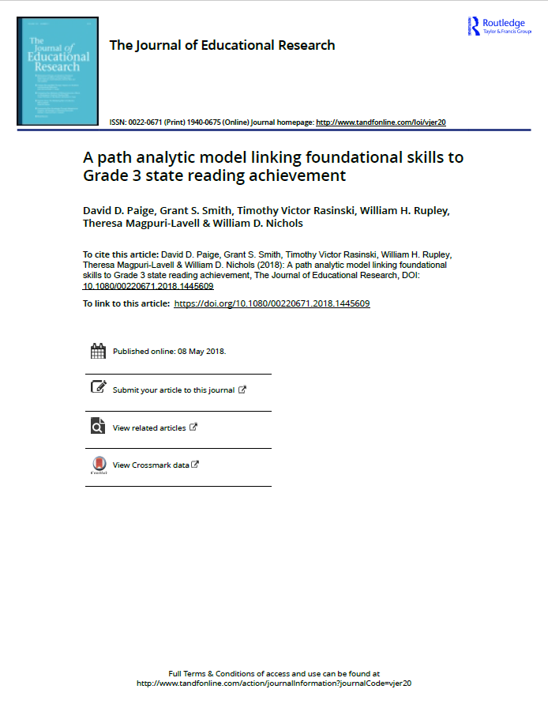
Recent Research We’ll Discuss Tonight
(2017)
David Paige study (2018)
David D. Paige, Grant S. Smith, Timothy Victor Rasinski, William H. Rupley, Theresa Magpuri-Lavell & William D. Nichols(2018) A path analytic model linking foundational skills to Grade 3 state reading achievement, The Journal of Educational Research, DOI: 10.1080/00220671.2018.1445609
Notes:
Two new pieces have come out in the past few years that show some really interesting things about reading. We’ll start with David Paige’s 2018 study.

Slide 12
Paige et. al (2018)
A path analytic model linking foundational skills to Grade 3 state reading achievement
1,064 3rd graders
Lowest performing schools in large low performing district in the southeast
Basal curriculum with structured phonics (unknown fidelity)
90-180 hours teacher training

Slide 13
Paige et. al (2018)
A path analytic model linking foundational skills to Grade 3 state reading achievement
Assessed Foundational Skills
Phonetically regular nonsense word (pseudoword) decoding | e.g., bap, reep, slipe, traiping
“Sight word” decoding | e.g., send, campground, cranberry
Spelling knowledge | Developmental Screening Inventory: 20 word spelling inventory, 4 stages Stage 1: jet, bump, mud Stage 2: make, car, cheer, boat Stage 3: jogged, smiling, lesson, advice Stage 4: wrist, diffuse, voyage
Fluency | Curriculum-based narrative passage (700 - 800L). Scored for Words Correct Per Minute.
Notes:
Decoding is accuracy + efficiency = ACCUMATICITY
SIGHT WORD AND PSEUDOWORD READING
Word reading is assessed using the Test of Word Reading Efﬁciency-2 (TOWRE; Torgesen, Wagner, & Rashotte, 2014). The TOWRE consists of two subtests that determine a students’ ability to efﬁciently (a) read sight-words (SWE) and (B) phonologically regular pseudo-words (PDE). The TOWRE is available in four forms, with Form B used in this study. The test is administered individually to each student. For each subtest, the student has 45 s to read aloud increasingly complicated words that are aligned in columns on the test page. The test administrator marks words read incorrectly with the raw score equal to the number of words read correctly for each subtest. The maximum possible score is 66 for pseudoword reading and 108 for sight word reading.
SPELLING KNOWLEDGE
https://www.scribd.com/doc/224775994/Developmental-Spelling-Assessment
The Developmental Screening Inventory (DSI; Ganske, 2014)is a group administered spelling assessment composed of 20 words that increase in spelling complexity. These 20 words are grouped into four sections of ﬁve words each that represent the four stages of spelling development (letter naming [LN], within-word [WW], syllable juncture [SJ], and derivational constancy [DC]) as described by Henderson and Templeton (1986).
Mastery of the LN stage means students understand initial and ﬁnal consonants, blends, and diagraphs, short vowels, and affricates (the speech sounds heard at the beginning of job and chop). The WW stage consists of letter-sound combinations made by long vowels (e.g., ate) and r-controlled vowels (letter features in which r fol-lows a vowel or team of vowels such as in hurt, fear, girl, and bird). Also in the WW stage are other common combinations of letters representing long vowel sounds (i.e., ai, ay, ee, ea, oa, and ui), complex consonant sounds (i.e., ck, kn, scr, thr, tch), vowel units (i.e., dge and qu), and abstract vowel sounds such as those read in pout, cow, toy, boil, and few. The SJ stage includes features such as doubling (jog and jogged) and the e-drop with -ed and -ing, long vowel patterns and r-controlled vowels within a stressed syllable, and vowel patterns within an unstressed syllable. The DC stage includes silent and sounded consonants, Latin-derived sufﬁxes, and assimilated preﬁxes. The DSI is untimed and group-administered where the teacher pronounces the target word aloud, reads it in a sentence, and then repeats the word. Students are given time to spell the target word on paper. Scoring of the DSI is done by awarding 1 point for each correctly spelled word for a total possible score ranging from 0 to 20. The assessed range in this study is 0 to 20, with 19 students attaining a score of 20. Two forms of the DSI are available, with Form A used in this study.
FLUENCY
To assess ﬂuent reading, students individually read aloud a curriculum-based narrative passage for 3 min while being scored for reading miscues (omissions, insertions, mispronounced words, reversals and skipping a line) by the test administrator. If after 3 s students were unable to read a word it was counted as an error, and the student was directed to continue reading. Total time spent reading was recorded for those who ﬁnished in less than 3 min. The passage was measured for Lexile complexity using the Lexile Analyzer (MetaMetrics, 2016) resulting in a 332-word, 700–800 L passage that is within the text complexity grade bands identiﬁed by the Common Core State Standards Initiative (2010) as appropriate for third-grade read-ers (420–850 L). To further assess text readability, the text was analyzed using Coh-Metrix (Graesser, McNamara, & Kuliko-wich, 2011), which determined it to be high in narrativity (75%), syntactic simplicity (77%), and word concreteness (85%), while low in referential and deep cohesion (18% and 46%, respectively). Curriculum-based measures have been shown to be valid measures of reading competency (Fuchs, Fuchs, Hosp, & Jenkins, 2001) while also possessing adequate reliability (Deno, 1985; Deno, Mirkin, & Chiang, 1982; McGlinchey & Hixson, 2004).

Slide 14
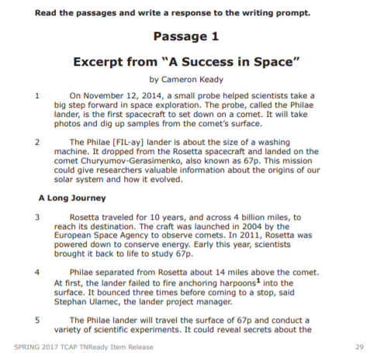
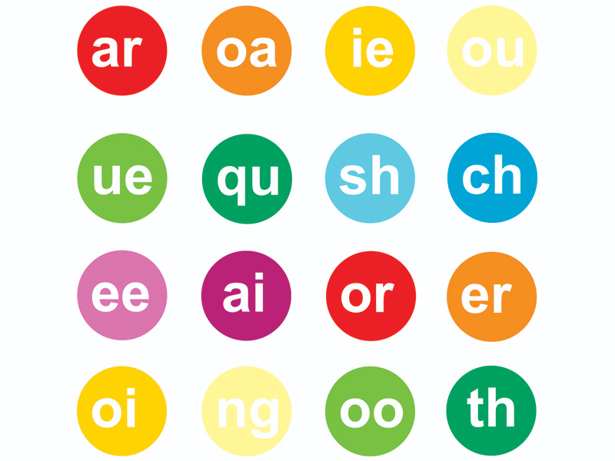

Impact of Foundational Skills Results on State Assessment of ELA Achievement
Students who were solid on foundational skills (spelling knowledge, pseudo word and sight word reading, fluency) had a ___% chance of passing the state assessment.
70
Notes:
Reminder: Lowest performing schools in this low performing district, using an unaligned basal program (that does have structured foundational skills instruction).

Slide 15

Structured Phonics Works
National Reading Panel: Meta-analysis concluding positive effects of systematic teaching of PA and phonics
Institute of Education Sciences: ES no further need to review what the evidence shows about the effectiveness of structured phonics programs
Looking for more? David Liben paper “Why Structured Phonics Program is Effective”

Slide 16

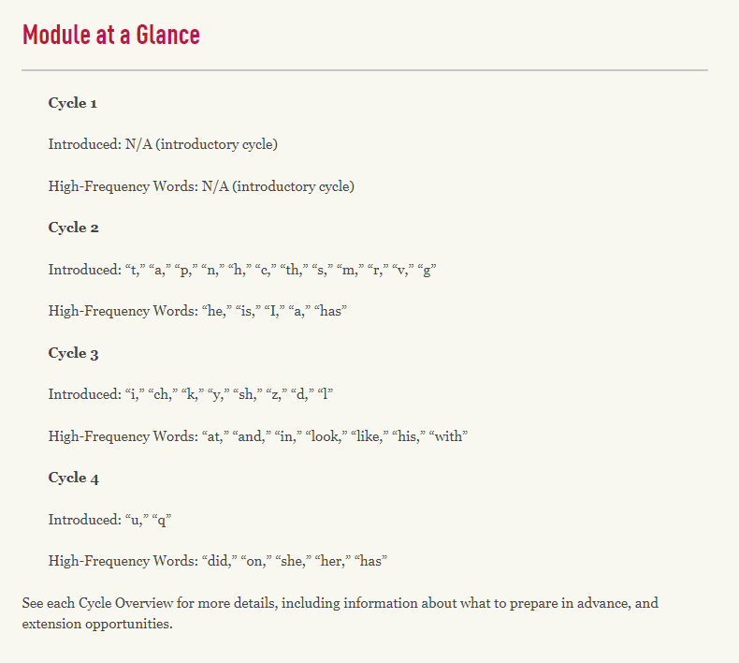
How We Teach Foundational Skills
Discrete skills that are taught explicitly in a research-grounded sequence, reinforced with practice (in and out of context) and assessed.
Notes:
Snip from EL Grade 1, Module 1
Foundational skills follows a sequence--how we SHOULD teach...

Slide 17

With this Explicit Instruction and Practice We Become More Skilled Decoders
wor_
work
worm
wore
word
worn
wort
more likely
“Redundancy”
Notes:
pg. 90
“Readers build neural structures that represent these statistical patterns and tune them every time a text is read. The mass of positive evidence about the limited set of patterns that do occur also carries information about patterns that do not.”
“The nonrandom way that letters combine mean that letters carry information about others that are likely to occur. This property is known as redundancy...[redundancy] decreases the uncertainty in how elements (letters, sounds, words, others) combine.”
Skilled readers have a strong knowledge of the statistical patterns of words. These patterns exist because English is highly redundant.
Which are real words? You can use your knowledge of statistical patterns to determine, even if you couldn’t explain how you know!
trig or gotr
sborg or rasbora
fobs or bsec

Slide 18
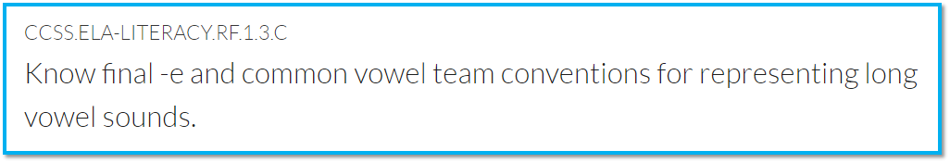

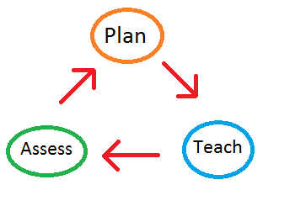

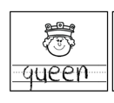


Foundational skills (print concepts, phonological awareness, phonics, word recognition, and fluency) need to be systematically taught and robustly practiced (in and out of context), skill after skill in a research-grounded sequence.
Scope & Sequence
Today we’ll learn that ee represents the /ē/ sound!
Notes:
The standards are your guide here, but you will also need a research-based scope and sequence of phonics patterns. With foundational skills, it does work to focus on a discrete skill, teach that skill and then assess that skill.

Slide 19
Section 2: How does traditional literacy comprehension instruction get it wrong?

Slide 20
Question:
How do you begin planning a lesson about a central text?
Please use the Questions tab on your control panel to submit your response.

Slide 21


Isolated Comprehension Skills Instruction
This week we’ll describe characters with The Snowy Day.
Notes:
“It’s February 3rd, it’s predictions week!”

Slide 22

Good Readers Draw on Many Skills & Strategies to Comprehend a Text
Standard of Coherence:
The types and strengths of coherence the reader aims to maintain during reading

Slide 23
Instead…
CCSS.ELA-LITERACY.RL.1.7
Use illustrations and details in a story to describe its characters, setting, or events.
CCSS.ELA-LITERACY.RL.1.4
Identify words and phrases in stories or poems that suggest feelings or appeal to the senses.
CCSS.ELA-LITERACY.RL.1.1
Ask and answer questions about key details in a text.
CCSS.ELA-LITERACY.RL.1.2
Retell stories, including key details, and demonstrate understanding of their central message or lesson.
How can I help students understand this text?
ELA reading, writing, listening and language standards should be approached holistically, the text itself pointing to what distinct standards arise from its particular demands.
Notes:
Reading/writing/speaking & listening standards are designed to be annual targets and reference points. They hold us to a common set of expectations for what well-educated students should be able to know and do by the end of each grade to be on track for success by the time students end their public school careers and move on into careers or more study, and into active engagement in civic affairs. These standards should be referenced in instructional planning and kept top of mind while teaching students to plumb, at the appropriate challenge, the particular structure(s), concepts, vocabulary, ideas, and details of the texts students are reading in order to consider what standard is being called for by the text demands. But they are not the goal of daily instruction.

Slide 24
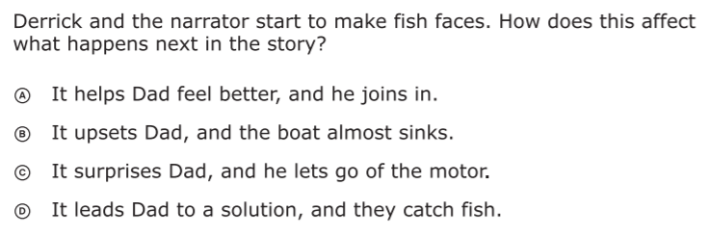
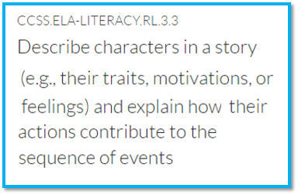
Traditional Literacy Instruction Oversimplifies Reading
Could be...
But could also be...
Vocabulary
Syntax
Density of information presented
Fluency
Stamina
Knowledge demands
...among other things.
Notes:
Question from released 3rd grade state assessment.

Slide 25

Using Isolated Comprehension Skills and Strategies in a Teach > Assess > Reteach Cycle...
“A smooth road in the wrong direction.”
-Silas Kulkarni, Teaching Lab
Notes:
Using a text-first approach is a rough road that may not be immediately apparent, but over time this method will become more and more clear.

Slide 26

Literacy Instruction Backwards
Traditional literacy instruction isolates, teaches, assesses and reteaches comprehension skills or standards.
Instead, we should use this method for foundational skills and let the text guide our reading comprehension instruction.

Slide 27

Equitable Instruction: Literacy Accelerators
ACCURATE DECODING AND FLUENCY
VOCABULARY
AND
KNOWLEDGE
Use systematic foundational skills instruction to solidify fluent reading of grade level text by Grade 3.
After students are reading fluently, let the text guide your planning and ensure students have access to complex texts with rich vocabulary and knowledge of the world.
Notes:
Seidenberg

Slide 28
Question:
What connections can you draw to your teaching practice or role? What are are you thinking about differently?
Please use the Questions tab on your control panel to submit your response.

Slide 29
Section 3: What does this look like in the classroom?

Slide 30

Aliya Washington
Nashville, TN
Lead Coach
Notes:
Janelle

Slide 31

Nashville Pilot
Working with K-2 teachers in 9 schools
Implemented:
  45 minutes for foundational skills
  Complex text read aloud with a focus on knowledge building

Slide 32

Successes Implementing This Approach
Improved student achievement and decrease in students requiring Tiers 2 & 3 intervention
Increased teacher knowledge and enthusiasm
Notes:
Improved student achievement in K-1 based on CBM (FAST Bridge)
Decrease in the number of students in K-1 requiring Tier 2/3 instruction
Increased teacher knowledge about foundational skills and enthusiasm about this approach to teaching reading

Slide 33

Challenges Implementing this Approach
Shifting thinking about instruction
Aligning leadership and teacher expectations
Notes:
Building teacher and instructional coaches' content knowledge - shifting thinking. We still have teachers and coaches that haven't taken ownership of explicit foundational skills instruction
Leadership - teachers begin to understand the importance of teaching foundational skills explicitly but fear their administrators may mark lower on yearly observation evaluations.

Slide 34
Questions for our guests?
Notes:
How do I do this if my materials don’t do this?

Slide 35

Join Our Network!
www.achievethecore.org/ca-signup
Notes:
If you found tonight’s webinar helpful, we’d like to invite you to join our Core Advocate network! We’re committed to solving real problems that real teachers have and we know the best way to do this is to know more about what folks are experiencing.
We’d love to learn about who you are, where you work, the types of things you’re interested in and the expertise you already have. This way, we will be able to tailor our webinars and other opportunities to your needs and interests (we may even tap you to be our next webinar panelist). So we encourage you to join the network by filling out this survey completely at atc.org/ca-signup

Slide 36
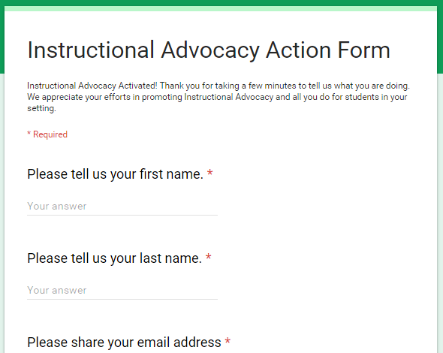
Tell Us About Your Efforts
www.achievethecore.org/educators-taking-action
Notes:
We like to invite Core Advocates to share what they are doing more broadly. Whether its you trying a strategy or a tool, we’d like to know how it went. Please let us know about your advocacy with our IAAF.

Slide 37

Please Join Us Again Next Month!
Next month’s webinar:
Don't Make Every Math Strategy a Separate Lesson: Developing Understanding and Skill with K-4 Operations
SAP Guests: Marni Greenstein and Shelbi Cole
Wednesday, August 8, 7:00 - 8:00 p.m. ET
Register Here:
https://attendee.gotowebinar.com/register/8508311637580332547

Slide 38
Thank You!

